Slide 1
Women’s Collective May 13, 2022

Slide 2
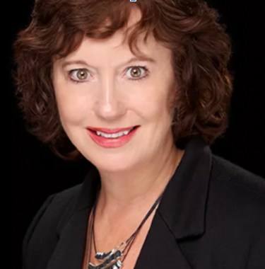
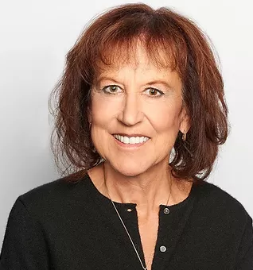
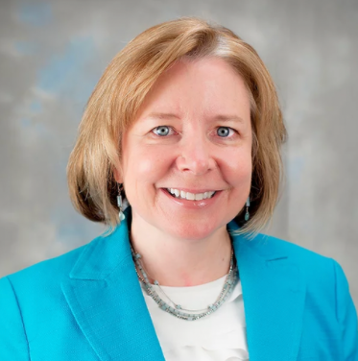
Introductions: Your Hosts
Sara Braziller
Pauline Allison
Julie Menten
Sahar Erickson

Slide 3
Agenda
Components of Powerful Communication
Undermining Speech: Patterns & Phrases
Why Are These Used?
Suggestions & Alternatives
Understanding Communication Styles
Active Listening
Effective Virtual Communication
Action Plan

Slide 4
Communicating with Power
What does that phrase mean to you?
Why is it important?
What would you like to takeaway from this session?
Please place your responses in the chat
Notes:
Having the effect on your audience that you want to have

Slide 5
Components of Powerful Communication
Authenticity
Commitment to your message
Clarity
Your key message
The result you want
Connection
Understanding of your audience – what are their types & needs
Lead with warmth
Confidence

Slide 6
Undermining Speech Phrases
I just wanted to….
I kind of…
I’m no expert, but…
Does that make sense?
Perhaps we could…
Okay?
Sorry to bother you…
This might be a bad idea…
Notes:
Called undermining because they erode confidence

Slide 7
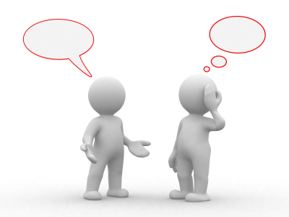
Undermining Speech Patterns
Making a statement sound like a question with voice lifting at the end
Apologizing when we are not at fault
Repeating ourselves to ensure we’re heard
Run on sentences to ensure we’re not interrupted
Speaking too quickly
Trailing off
Nervous laughter
Filling the silence
Notes:
This Photo by Unknown Author is licensed under CC BY-NC

Slide 8
Undermining Body Gestures
Stance
Avoid slouching
Center weight on both feet
Face your audience
“Put your shoulders in your back pockets”
Wrapping yourself with your arms
Conveys image of powerless
Folded arms
May be cold body temperature although often interpreted as being closed off
Nervous movement
Clicking your pen, tapping fingers, bouncing leg
Eye contact
Know where camera is on your computer
If in person, don’t look down – look at your audience
Be culturally aware, especially of hand gestures
Notes:
This Photo by Unknown Author is licensed under CC BY-SA-NC
Hand gestures to avoid: OK sign, thumbs up, signaling for someone to come forward with your finger, peace sign with the back of the hand facing out

Slide 9
How to Feel Confident: Power Posture
“Body leads the Mind” – Amy Cuddy, Harvard professor and researcher
CBS Mornings
Stand like wonder woman or strike a victory pose before you go “onstage”
Optimizes your brain
Instead of internal message “I’m anxious”, say “I’m excited”

Slide 10
What other undermining speech patterns and phrases have you heard or used? (also think about emails and texts)
Notes:
Making nouns into a verb
Using acronyms

Slide 11
What do you think about “ahs”, “ums” and “you know”?

Slide 12
Why Does it Matter?
You have important ideas and thoughts to share
You have a right to be heard and understood
You want your audience to understand your message
Some speech patterns can convey doubt or tentativeness
Any additional reasons?

Slide 13
Why Do We Use Undermining Speech Patterns?
Habit
Reflecting our own inner self-doubt
Desire to reassure the audience we have no negative intentions
Strong history of cultural messaging, especially for women and people of color

Slide 14
Historical Context
In 2400 to 2300 BC Mesopotamia, there was a law stating that if a woman speaks out of turn, she will be smashed by a brick.
Scold’s Bridle – a form of punishment reserved exclusively for women whose talk was deemed to be inappropriate
Notes:
Image from BBC A History of the World

Slide 15
Cultural Messaging
Double bind – being likable and competent
Any marginalized lower-power group will struggle to be seen as both likeable and competent while the higher-power group is perceived as naturally having both

Slide 16
Acknowledge the Double Standard
Notes:
Pantene Labels Against Women

Slide 17
Really Important Caveat
“What’s really destructive and undermining to women is not their way of speaking but the constant criticism to which their speech is subjected. Telling women their speech-habits are bad and wrong is not going to make them more confident speakers: it’s more likely to reduce them to silence. Continually repeating that women’s speech lacks authority just gives people yet another reason to dismiss whatever they say as unworthy of serious attention.”
Debbie Cameron, July 27, 2015 “An Open Letter to Naomi Wolf: Let Women Speak How They Please”

Slide 18
A Response to, “Are we placing self-blame on women once again?”
I think the unlearning can be part of an empowerment process, but it’s helpful to remember that context. This isn’t just “I’m personally doing something wrong in my speech and it’s holding me back and so I have to change it.” It’s “No. I inherit these patterns and these messages from a culture. They’re causing me to talk in a certain way. Now, I might choose something different for myself as an adult.”
-Tara Mohr, author and coach
Think of it as nurturing yourself by providing new skill sets

Slide 19
Practical Tips

Slide 20
Overcoming the Double Standard
Convey warmth first
Initial impression - instantly
Authentically connect with your audience
Genuinely take an interest by asking questions
Start with a personal story
Nonverbals: smile, nod, open stance
Then build capability with your clear messaging
Notes:
Unfortunate that women, black, indigenous and people of color need to be more deliberate about continuously conveying warmth
Exhausting, but reality
Is there someone you admire – in politics, public – how do they convey both warmth and competence?

Slide 21
“Does this make sense?”
Can be interpreted as: Did I make sense?
Alternatives
What are your thoughts about this?
I value your input. What do you think about this?
Notes:
What are some alternatives to undermining speech?

Slide 22
Forming Questions Instead of Opinions
Overtime frequent use of questions may be perceived as not raising important points because the ideas are hidden in questions
“What about charging more for our product?”
“I’m not the expert, but what do you think about charging more?”
Alternative: State your recommendation
“I think we need to increase the price of our product.”

Slide 23
What if you don’t know the answer?
Get the information and quickly follow up
“Good question. I don’t know the answer today. I will follow up with an email by the end of the week.”

Slide 24
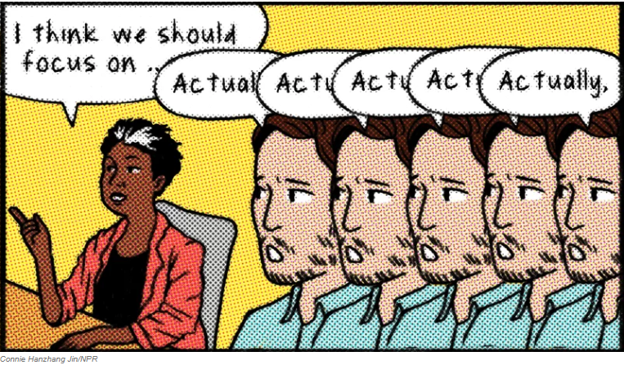
How to handle if interrupted?
“Yes, I love what you’re saying. That relates to what I was saying….”
If presenting, capture the comment in a “parking lot” and state you’ll return to that later
If in a meeting, use the women in Obama administration tactic
One woman makes a point in a meeting and, immediately, another woman would repeat the idea and commend it. And then a third woman would chime in and move the idea forward.

Slide 25
Understanding Communication Styles
Understanding yours and your audience’s
Direct
Get to the point & focus on outcomes
Analytical
Be prepared to answer questions
Offer to follow up with additional detail
Caring & Sharing
Collaborative discussion
How to identify someone’s communication style:
If speaking to an individual, think about their style of speaking
If speaking to a group, why is the audience there?
Tap into numerous resources such as DISC, Insights Discovery®

Slide 26
Active Listening is a Powerful Communication Skill
Full attention to the speaker
Make eye contact
Withhold judgement
Ask open ended questions

Slide 27
Tips for Effective Communication Virtually
Have natural, if possible, front lighting
Blur your background
Place your camera at eye level
Put a Post-it Note® next to it
Practice your position & distance; frame your face and shoulders
Don’t slouch
Don’t get distracted e.g., glancing down at your phone
Try to avoid WIFI if possible
Mute yourself if not presenting
Have a helper check the chats, tell you if the sound is poor, etc.
Have fun!

Slide 28
Professional Emails
Include a clear subject line
Email from a professional email address
Use a professional greeting
Write an introduction
Avoid all CAPS
Proofread
Keep the tone professional and without emojis
Perfect your email signature
Use a professional closing
Notes:
JULIE
1. Use standard formatting
(Standard fonts, such as Times New Roman or Arial, as well as standard colors and sizes are appropriate for business emails. If you use bold or italics, never use them on more than one word or a string of words in a single email.
2. Include a clear subject line
(Title your email in a way that the recipient immediately knows what the message is about. For example, if you’re emailing to follow up on a presentation, you might write, “Quick question about your presentation.”)
3. Email from a professional email address
(Use your company email address if possible. However, if you are self-employed or using a personal email address for work-related correspondence, make sure that your email address doesn’t contain any words that would be considered unprofessional. If so, then consider setting up a work-only email address.)
4. Use professional greetings
(Choose a salutation that is appropriate for the relationship you have with the recipient. If you are sending an email to a coworker, a casual greeting such as “Hello” may be appropriate. If you’re contacting someone for the first time or if they are a professional acquaintance, use a more formal greeting like “Dear Sarah Atkins.” It’s recommended to use the person’s name exactly as it’s shown in their email signature line. In other words, don’t assume that Jennifer goes by Jen unless you’ve seen them sign their emails that way.)
5. Use an introduction
(Depending on who you are emailing, it’s best to introduce yourself by your first and last name, as well as the company you are representing, in the first few lines. This is especially important when emailing new contacts, clients, potential customers or employers. Let them know how you received their contact information.)
7. Avoid using all caps
(Use sentence case as you would for any formal communication, and avoid using all caps as it can read like you’re screaming your intentions. )
9. Proofread
(Proper spelling and grammar are important when sending business correspondence so always proofread your work before you hit send. Likewise, double-check the spelling of the recipient’s name and email address. Sometimes autocorrect will alter names. )
10. Don’t use emojis
Unless the recipient has used emojis when communicating with you in the past, resist the temptation to use them yourself. They can come across as unprofessional in certain company cultures.
12. Keep your tone professional
Think carefully about your word choices in an email and how your intention may be interpreted. Use positive words, such as “opportunities” and “challenges” instead of “obstacles” and “limitations.” Avoid negativity, sarcasm and adjectives that can cause you to sound overly emotional. Be careful when using humor too, as it can be misinterpreted.
13. Perfect your email signature
Less is generally more where email signatures
are concerned. Your signature should typically include only your name, job title, company website and a phone number where you can be reached.
Professional email closing examples
Here are a few of the most common ways to end a professional email:
Best
Sincerely
Regards
Kind regards
Thank you
Warm wishes
With gratitude
Many thanks
Respectfully
Examples of email closings to avoid
Here are some email closing phrases you should avoid in professional environments:
Your friend
Cheers
Peace
Thanks a bunch
Chat soon
Yours truly

Slide 29
Business Texting Etiquette Tips
Get consent from your clients/customers before texting them
Identify yourself in your first text
Keep your text messages on brand
Personalize your business texts
Proofread every post (don’t rely on autocorrect)
Refrain from texting confidential information
Don’t use emojis
Be concise
Stay within business hours
End your text conversations gracefully

Slide 30
Avoid Acronyms & Abbreviations
Do you definitely know what it stands for?
Will your entire audience know what it stands for?
Does it improve or hurt communication efficiency?
When LOL is misinterpreted as Lots of Love instead of Laugh Out Loud
Notes:
JULIE
This Photo by Unknown Author is licensed under CC BY-NC

Slide 31
Avoid the Dreaded Overused Buzzwords
New normal
Synergy
Circle back
Take this offline
Pivot
Think outside the box
Bandwidth
Work from home
Low-hanging fruit
Notes:
JULIE
This Photo by Unknown Author is licensed under CC BY

Slide 32
Components of Powerful Communication
Relax & breathe through your diaphragm
Use a power posture before entering the presentation
Keep your main message simple, concise & memorable
Deliberately convey warmth
NOT through hedging phrases or dumbing down
Instead through an authentic connection
Avoid jargon and acronyms
Pay attention to body language
Practice your message OUT LOUD
Notes:
JULIE

Slide 33
Key Takeaways and Action Plan
Take a few moments to jot down one or two ideas or tips you are going to implement
Add a 10-minute calendar entry one week out. Use this as a check-in. Have you incorporated these tips into your communications?
Notes:
JULIE

Slide 34
Next Session
Date: August 12
Potential topics from our survey
Negotiating Skills
Networking Skills
Crafting and Practicing Your Elevator Pitch
Engaging a Social Mission in Your Business
Any of these of interest? Please write them in the chat.
Any other ideas? Please write them in the chat.
Notes:
JULIE

Slide 35
Update on Minneapolis Business Mentors
Upcoming Free MBMentors Webinars
Social Media Marketing May 18, 10am – 11:15am
Are You Ready to Start a Business May 25, 9am – 10:15am
LivePlan Lean Business Plan June 2, 10am – 11:15am
Free mentoring
Request this service via our website: mbmentors.org
MBM Client Community
Mbmentors.org/forum
Women’s Collective
Notes:
JULIE

Slide 36
Women’s Collective Thank you!

Slide 37
Sources:
Naomi Wolf, July 24, 2015, ‘Young Women, give up the vocal fry and reclaim your strong female voice’, The Guardian
Jen Murtah, April 29, 2021, ‘Why Women Need to Stop Using Undermining Speech Patterns’, Life in Law
Tara Mohr, Playing Big, New York: Penguin Random House, 2014
National Public Radio, ‘Taking up space at work isn’t easy. Here’s how employees can speak up for one another.’ October 2, 2021
Mary Abbajay, April 20, 2020, ‘Best Practices for Virtual Presentations: 15 Expert Tips That Work for Everyone’, Forbes

